Slide 1

DAA ASSIGNMENT
Submitted By:
Shivani Pal – IIT2021504
Rhythm Jain – IIT2021505
Aditya Yalamanchi – IIB2021001
Nitesh Kumar Shah – IIB2021002
Given By: Dr.Mohammed Javed
Guided by: Mr. Bhavesh Kumar Bohora

Slide 2
QUESTION
DEVELOP AN ALGORITHM TO COMPUTE THE SUM OF THE FIRST n TERMS (n>=1) OF THE SERIES
S=1-3+5-7+9-........

Slide 3
Algo 1
1. The algorithm takes input from the user for the value of n and uses a variable "k" which starts from 1 and increases by 2 in each iteration to represent the current term of the sequence.
2. The algorithm uses a variable "sum" to keep track of the running total of the sum and a variable "t" to keep track of the number of operations performed.
3. In each iteration, the algorithm checks if the current term is odd or even. If the current term is odd, the algorithm adds the value of "k" to the variable "sum" and prints the current term followed by a "-" sign.
4. If the current term is even, the algorithm subtracts the value of "k" from the variable "sum" and prints the current term followed by a "+" sign.
5. After all the terms have been processed, the algorithm prints the final sum. Also, it prints the value of "t" which represents the total number of operations used in the algorithm.

Slide 4
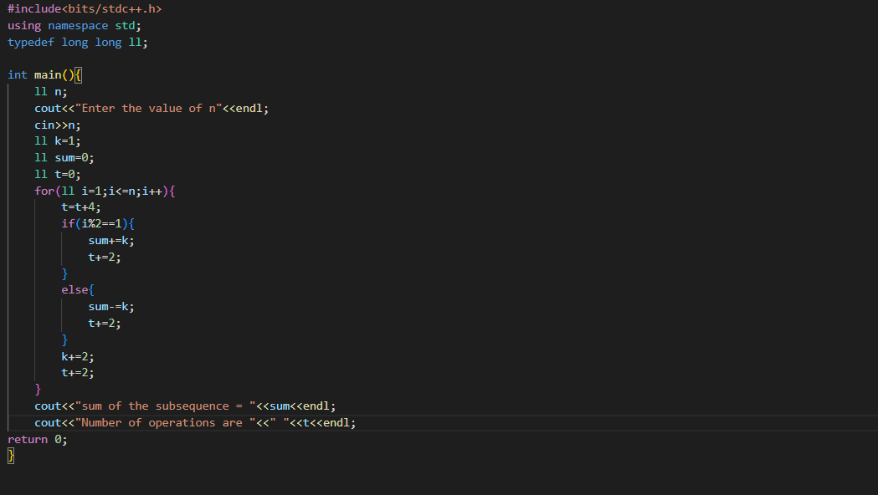
Code 1:

Slide 5
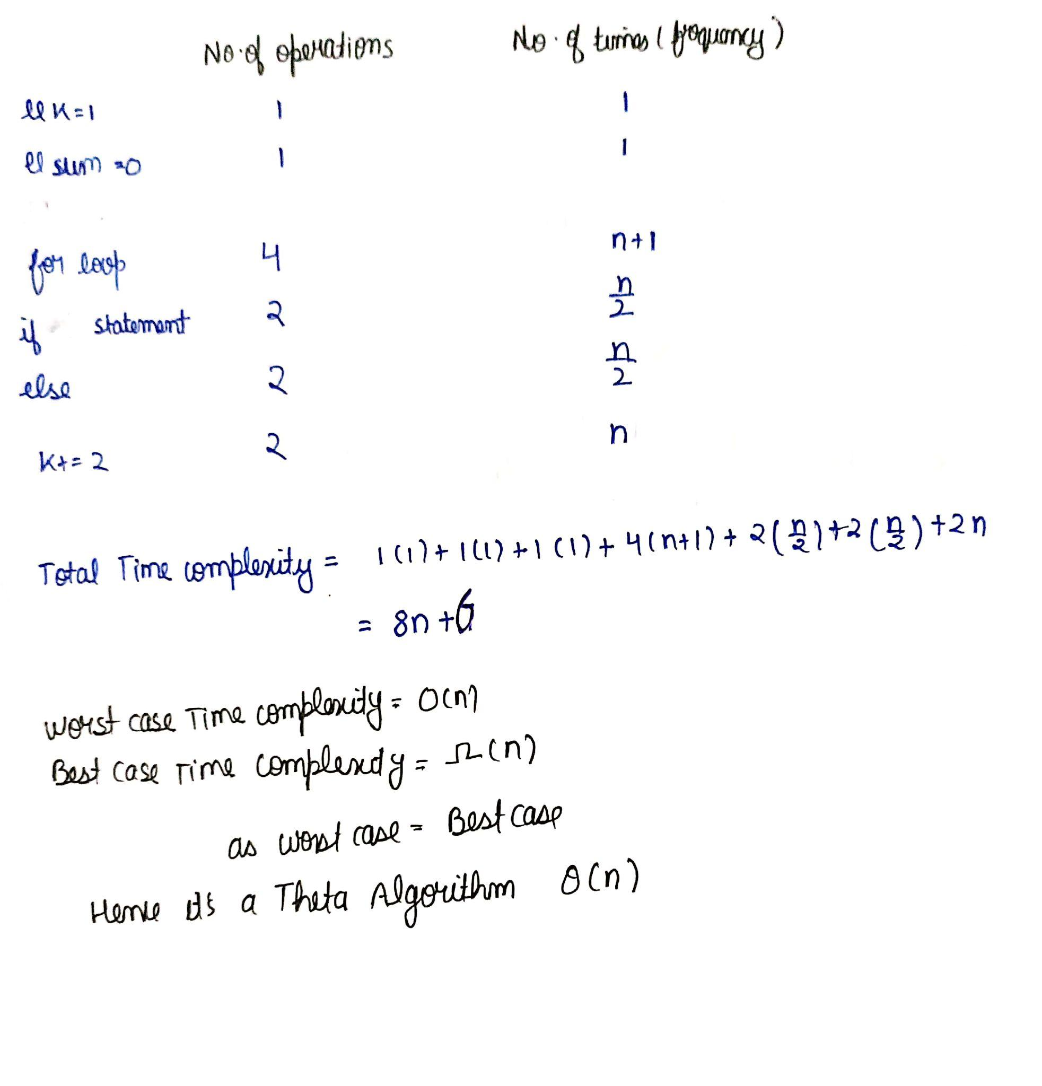
TIME COMPLEXITY

Slide 6
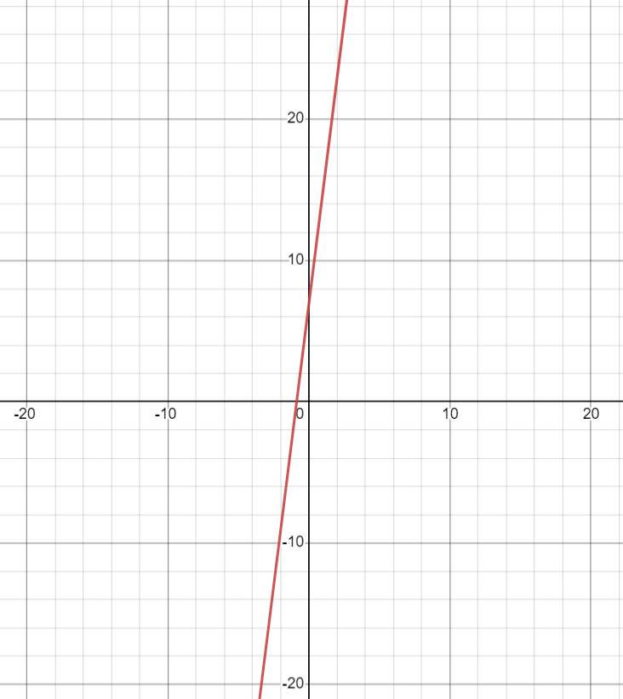
GRAPH
y=8n+6

Slide 7
Space Complexity (Algo-1)
The Space Complexity of all the algorithms is O(1) for the best case, the average case and the worst case because it uses a single variable.

Slide 8
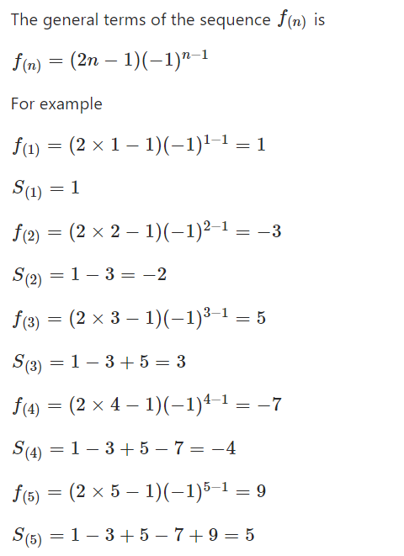
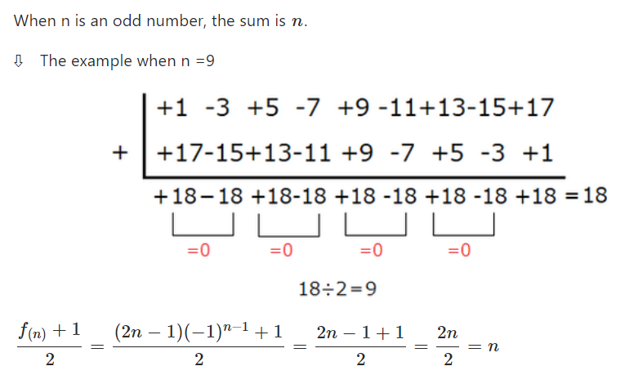
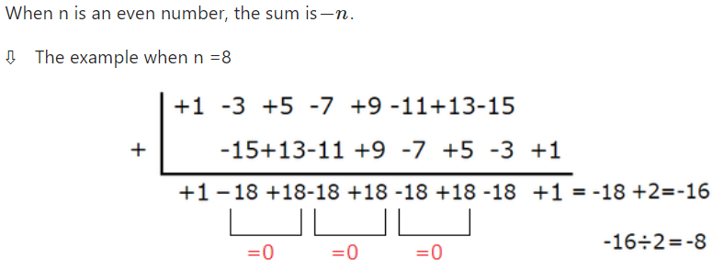
Algo 2
The first algorithms optimized solution is provided by our second algorithm. Below, we'll go over how the upgraded version functions.

Slide 9
This code is the implementation of the mathematical approach explained in the slide above. The Algorithm calculates the sum of a subsequence of integers and the number of operations performed to get the sum.
The code prompts the user to enter the value of n, and calculates the sum of the subsequence (either n or -n, depending on whether n is even or odd).
Finally, it outputs the sum and the number of operations.

Slide 10
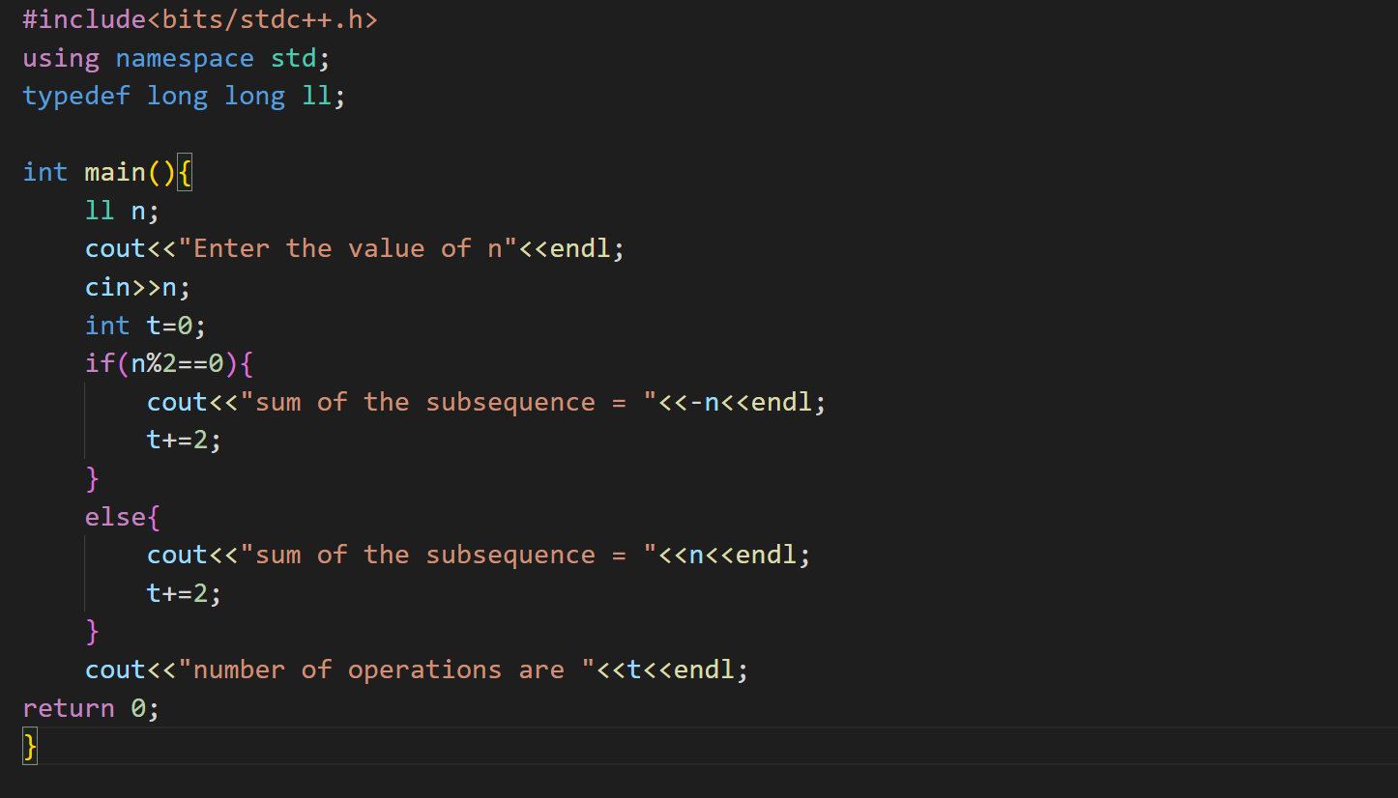
Code 2: (Optimized)

Slide 11
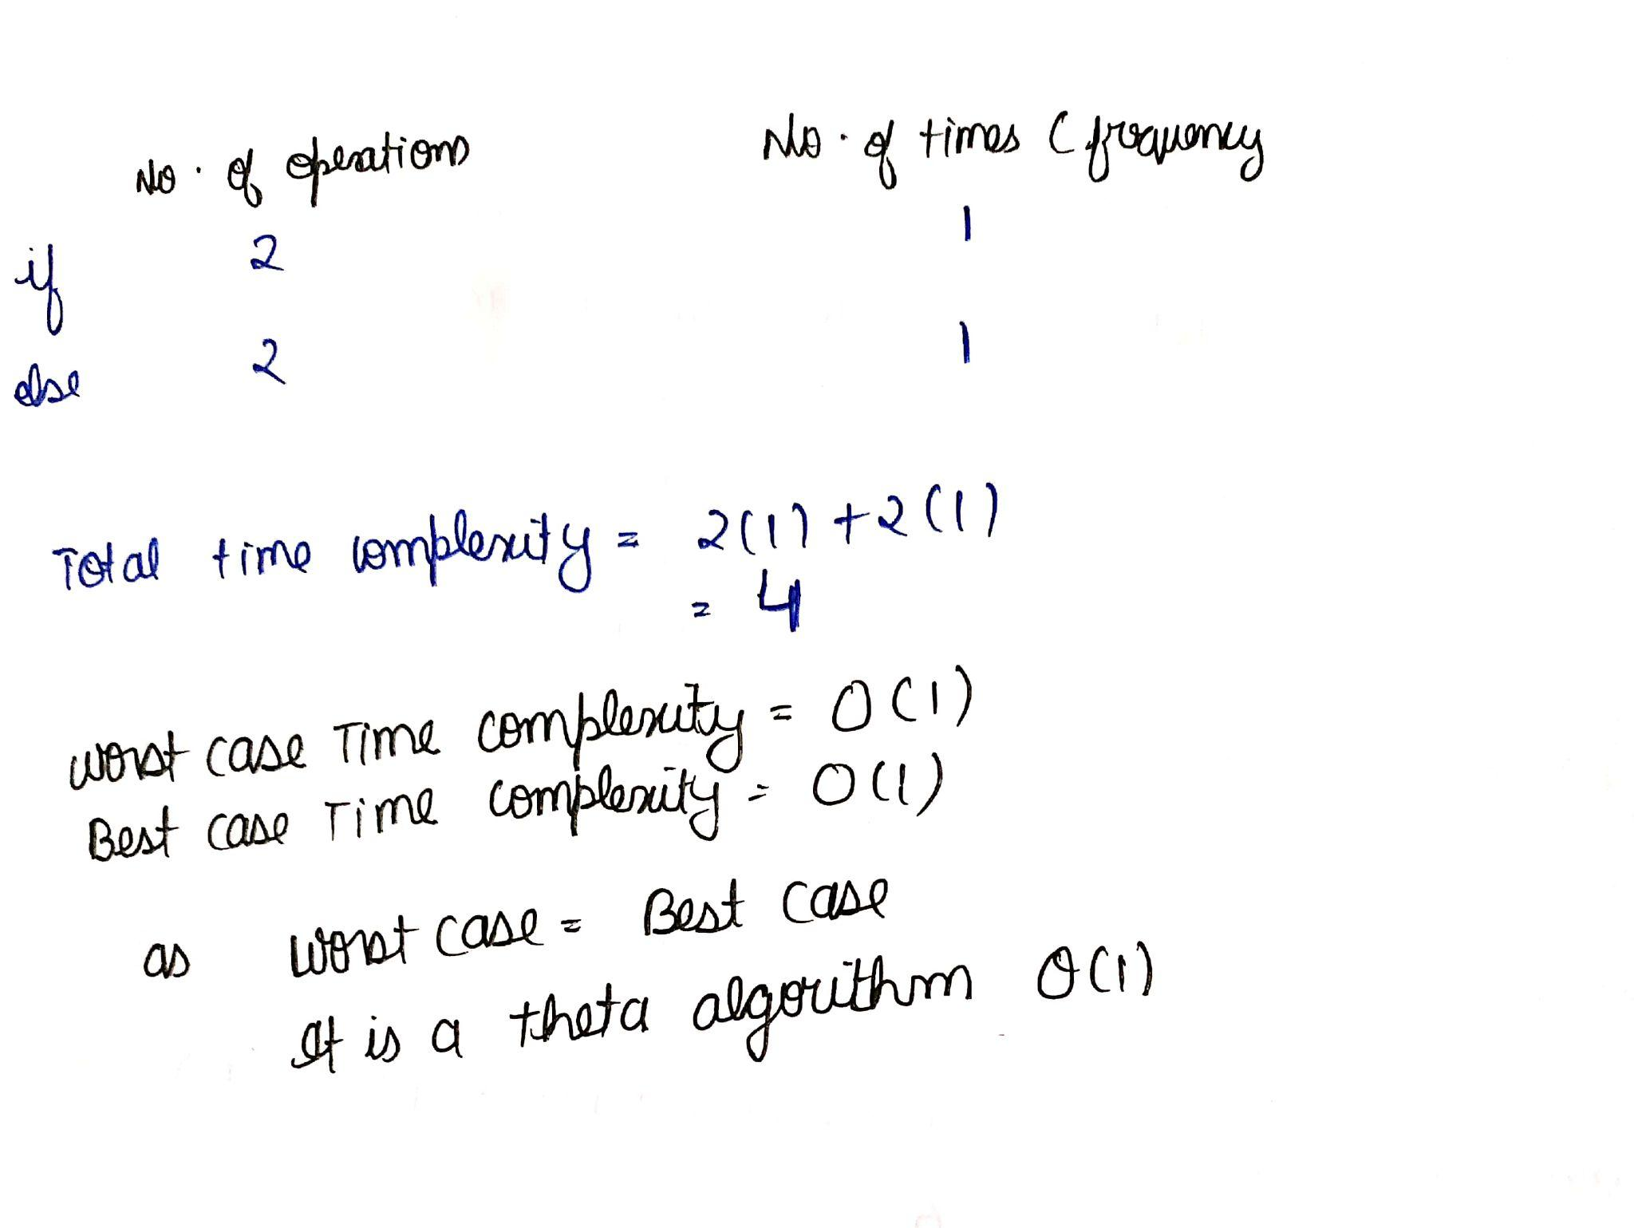
TIME COMPLEXITY

Slide 12
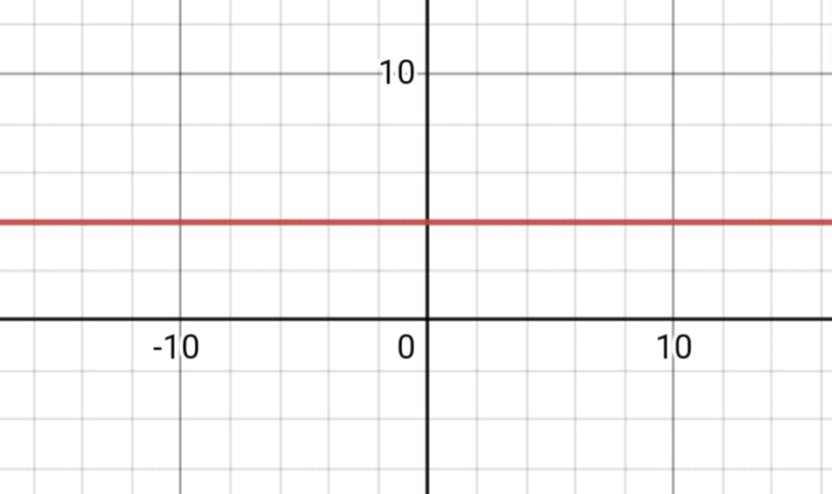
GRAPH
y=4

Slide 13
SPACE COMPLEXITY
The space complexity of all the algorithms is O(1) for the best case, the average case and the worst case because it uses a single variable.

Slide 14
Conclusion We applied the concepts we learned in class to the given problem and created an algorithm with varying temporal complexities. Finally, we developed an algorithm that runs continuously. We also looked at the process and the number of operations for different inputs.

